Slide 1
Intro to AI
6 lectures
Mária Markošová
I34
markosova@ii.fmph.uniba.sk

Slide 2
Conditions
Attend the exercises; Mgr Pocos. All about exercises is in his competence.
All lectures, slides in English and Slovak will be on the faculty Moodle.
Evaluation: 50 percent exercises, 50 percent exam. You need to have 25 percent on exercises in order absolve exams.
Exam is written, based on the problem solving, not on the definitions.

Slide 3
What is intelligence?
Definitions from dictionary.
a) Intelligence is an ability to gain and process knowledge .
b) Intelligence is an ability to think and derive new knowledge.
c) Intelligence is
-the ability to learn or understand or to deal with new or trying situations
-the skilled use of reason
-the ability to apply knowledge to manipulate one's environment or to
think abstractly as measured by objective criteria (as tests) (online
webster)

Slide 4
Technological definition
Intelligence is an ability to process an information (processing capability)
3. Definition from Encyclopedia (Columbia Univerzity Press)
It is a power of the mind which includes calculation, inference, reasoning, learning, classification and generalization.
Definition of psychologists
a) Binet’s definition (Binet, fr. psychológ): Intelligence is a totality of mental processes, which leads to the adaptation.
b) Callel’s definition (Raymond Callel, psychológ): Intelligence has two parts: fluid ability is a basic mental power to do conclusions and : crystalized ability are all knowledges gained by experience in a cultural environment.

Slide 5
Medical definition
Intelligence is an ability to gain and process knowledges for a certain goal..
Legg a Hutter (2007): Intelligence measures an agent’s ability to achieve goals in a wide range of environments.

Slide 6
What is AI ?
Kelemen a kol. (Základy umelej inteligencie, Alfa, 1992) :
AI is an artificial phenomenon resembling a human intelligence.
AI is a wide spectrum of methods trying to realize AI defined under a)
AI is an area of research which looks for the limits of symbolic representation of the reality.
Návrat a kol. (Umelá inteligencia, Vydavateľstvo STU, 2001):
The goal of AI is to realize an intelligent objects and to understand their behavior. The goal of AI is not to find an answer what is intelligence in general.

Slide 7
Šefránek (Inteligencia ako výpočet, IRIS, 2000):
The core of AI is an afford to model an intelligent behavior and thinking with a help of computation and information processing.
Russel, Norvig (Artificial Intelligence; a modern approach, Prentice – Hall 1995):
AI is the exciting new afford to make computers think, to make machines with minds in the full and literal sence (Haugeland, 1985)
AI studies mental faculties through the use of computational models (Charniak and Mc Dermott, 1985). It is the study of the computations that make it possible to perceive, reason and act.(Winston, 1992)

Slide 8
AI is a field of study that seeks to explain and emulate intelligent behavior in terms of computational processes. (Schalkoff, 1990)
AI is the branch of computer science that is connected with the automatization of intelligent behavior“ (Luger and Stubblefield, 1993)
Nils J. Nilsson, Artificial intelligence: A new synthesis (1998)
AI concerns with intelligent behavior in artifacts. Intelligent behavior involves perception, reasoning, learning, communicating and acting in complex environments.
Long term goal of AI: Developement of machines, that can do these things as human can.
Notes:
Toto je zároven aj odporúčaná literatúra k predmetu.

Slide 9
Categories of AI
Symbolic AI (the oldest part of AI based on symbols and logic as the language for the agents)
2. Subsymbolic AI (neural nets, genetic algorithma, inspired by human thinking)

Slide 10
Symbolic AI
Based on the Newel a Simon hypothesis, 1976:
Physical symbolic system is a machine able to process the symbols.
The concept of agent is crucial.
We use a knowledge base written in a language of logic, knowledges are represented as a logical sentences.
Domain of the agent’s activity should be well described.

Slide 11
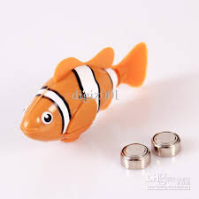
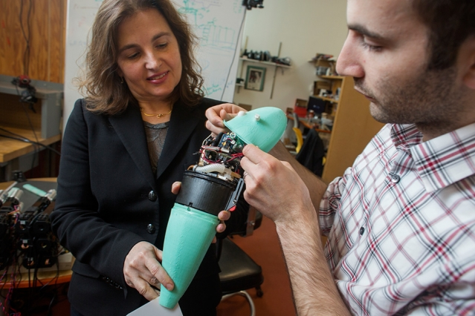
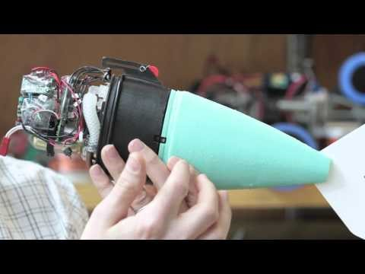
Agent example: robotic fish
Toy robotic fish: percepts water and this percept is mapped to the action - movement.
Complex robotic fish developed at MIT: http://news.mit.edu/2014/soft-robotic-fish-moves-like-the-real-thing-0313

Slide 12
Agent
Let us call the robotic fish an agent. What should agent designer do to make robotic fish perform as an alive animal?
1. The fish must have some senzors to percept the environment.
2. The must have an actuators (tail, fin) to perform a task in the
environment.
3. The robotic fish must have a agent program, which maps the
percept into an appropriate action. This program is a realization
of the agent function.

Slide 13

Agent: definition
Agent is a system (robot, man, softbot...), which percepts its environment with a help of sensors and acts in the environment with a help of actuators.
Sensors: camera, infrared sensor, temperature sensor
Actuators: tail, fin in robotic fish, artificial hand, wheels
Robotic agents
Senzors: eyes, nose, ears …
Efektory: hands, feet, pistol ….
Agent 001
Notes:
A Softbot is an Intelligent Software Agent that serves as the software equivalent of a hardware-based robot.

Slide 14
Percept: State of the environment seen by the agent at certain time.
Percept sequence: History of percepts in time.
Action: Agent ‘s intervention into the environment
based on the current percept or percept
sequence. The environment is then changed by a
defined way.
How to design an agent:
A designer should specify and agent function and make an agent program as a realization of the agent function.

Slide 15
Designing intelligent agents:
Knowledge acquisition level: programmer specifies which knowledges are necessary to describe the world in which an agent acts. Simplification of the world is necessary. Designer creates a task environment – a simplification of the real world.
Symbol level: representation of the knowledges with a help of symbolic structures, operators above these structures are defined.
Level of implementation: implementation of the inference methods for a new knowledges derivation and best agent’s action derivation, implementation of the agent program, realization of the agent.

Slide 16
Paradigmatic example
robot
S1
S2
S3
S8
S4
obstacle
S7
S6
S5
s =0 free square
s=1 square with obstacle

Slide 17
Paradigmatic example
robot
S1
S2
S3
S8
S4
obstacle
S7
S6
S5
s =0 free square
s=1 square with an obstacle

Slide 18
Robot: let us call him agent.
What should robot – agent know to fulfill the task?
To percept the environment
To process the percepts
On the basis of the previous percepts to choose the best action
Percept?
Binary vector: (00000000), (00011100), etc
Agent function?
Action f(percept)
Agent program?
For each percept we have a rule:
if (percept) then (action)

Slide 19
Paradigmatic example
robot
S1
S2
S3
S8
S4
obstacle
S7
S6
S5
s =0
s=1

Slide 20
Paradigmatic example
The same situation,
S1
S2
S3
S8
S4
S7
S6
S5
s =0
s=1

Slide 21
Paradigmatic example
The same situation as before
S1
S2
S3
S8
S4
S7
S6
S5
s =0
s=1

Slide 22
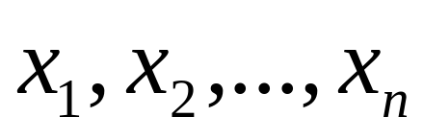
Agent function: maps percepts to the action
Effective representation of the agent function?
Binary vector is replaced by the feature vector.
Features: numerical features
categorial features (colour for example)
Extraction of features is based on the fact we do not have narrow spaces.
Notes:
Numerické: 0,1 Kategoriálne: false, true
reálne čisla red, blue,

Slide 23



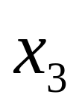
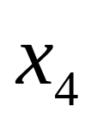
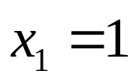
S1 S2 S3
Each feature has a value 1 if at least one marked square is not free. Else, it has a value zero. For example if s2=1 or s3=1.
We have only few features.

Slide 24
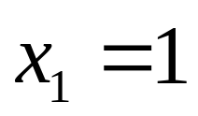
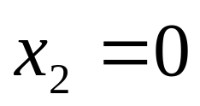
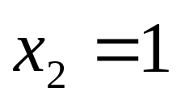
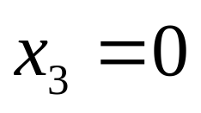
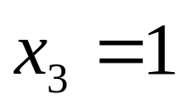
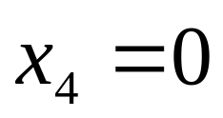
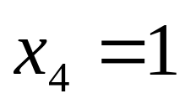
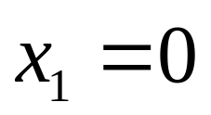
Better agent function representation:
if and then move east
if and then move south
if and then move west
if and then move north
Situation on previous
figs

Slide 25
Agent function of our robot:
if and then move east
if and then move south
if and then move west
if and then move north
What is missing in these rules??
How to move robot distant from the obstacle..

Slide 26

Suggest percept reprezentation ? What is an action ?
Percept [A,Dirty]
Actions: Left, Right, Suck, NoOp

Slide 27
Agent function ?
Percept sequence
Action
[A, Clean] Right
[A, Dirty] Suck
[B, Clean] Left
[B, Dirty] Suck
[A, Clean] [A, Clean] Right
[A, Clean] [A, Dirty] Suck
. . .
[A, Clean] [A, Clean] [A, Dirty] Suck
Agent program?
Agent program: implementation of the table

Slide 28
Performance measure
Performance measure: Measure which measures how well agent performs the given task.
Performance mesure is defined by designer, this measure depends on what is a suitable state of the environment.
What is the wish state of the environmetn for the agent automatic vaccum cleaner?

Slide 29
Performance measure possible definitions :
Example: rooms with automatic vacuum cleaner
choice: P.m. is measured by the amount of dirt cleaned in a time unit.
choice: P.m. is measured by a time during which the floor is clean.
choice: P.m. is measured by the number of steps in a time unit. We want to
minimize this number.
4: choice: P.m. is measured by score (point for cleaned room, minus one point
for each step, etc.) in a time unit.

Slide 30
Ideal rational agent: definition
Ideal rational agent acts by such a way, that for each possible percept sequence chooses an action, which maximizes the ‘performance measure’. Maximization is with respect to actual percept and knowledge of the agent.
Another properties of the ideal rational agent:
Autonomy and ability to learn.
Is the boundary following agent and the vacuum cleaner ideal rational agent?

Slide 31
PEAS deacription: aid for the agent designer
PEAS: Performance measure, Environment, Actuators, Sensors
Example of the agent: automatic taxi driver:
  Performance measure
  Environment
  Actuators
  Sensors

Slide 32
PEAS
Agent: Automatic taxi driver
Performance measure: for example the number of transported people in time unit.
Environment: streets
Actuators: wheels, GPS
Sensors: camera, transmitter

Slide 33
PEAS
Agent: Robot exploring the planet Mars
Performance measure: Possibilities:
1. Number of samples collected in a time
unit.
2. Number of photographs taken in one time
unit. Etc.
3. Or a combination of several weighted quantities.
Environment: planet surface
Actuators: Artificial hand, camera
Sensors: camera, infrared sensor, transmitter…

Slide 34
PEAS
Agent: Agent selling the books on the internet
Performance measure: Number of book sold in certain time unit. Gain during some time period. Etc.
Environment: internet
Actuators: display, robotic hand
Sensors: automatic order reader

Slide 35
Environment of the agent
type of the environment type of the agent
performance m. task environment
Task environment environment

Slide 36
Task environment
Task environment: it is an abstraction, simplification of the real environment in which the agent acts. The environment is stripped of unimportant elements (from the task point of view).
Vacuum cleaner world:
Environment: Real empty rooms.
Task environment: Abstraction of real empty rooms, in which we do not care, for example, about the color of walls, pictures hanged on the walls, disposition of windows ....

Slide 37
Types of task environments
Observable vs. unobservable, or partially observable: Sensors of the agent percept the environment as a whole if the environment is observable.
Deterministic vs. undeterministic: If the next state of the environment is totally dependant on the actual state and the agent action, the environment is deterministic.
Epizodic vs. unepizodic: Actual action depends only on the actual percept. Previous actions does not influence actual action. Agent’s experience depends on episodes percept – action.
Discrete vs. continuous: In the discrete environment the number of percepts and connected actions is limited and well defined (example: chess board).
Static vs. dynamic: If the environment changes not only due to the agent action, it is a dynamic environment.
Single agentové vs. multi agent:

Slide 38
Typs of simple agents
Simple reflex agents
Model-based reflex agents
Goal-based agents
Utility-based agents

Slide 39
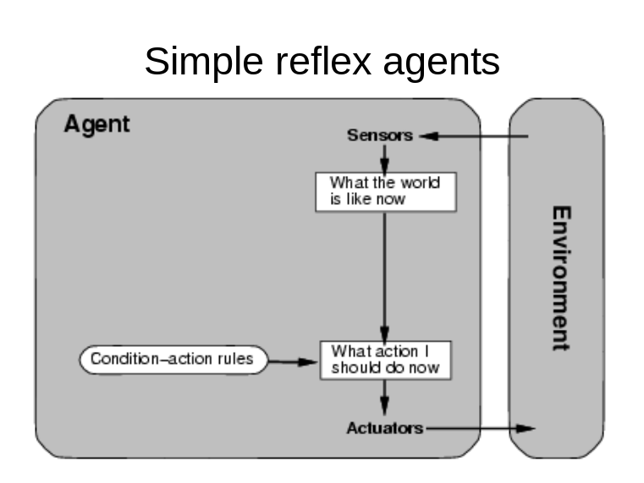
Simple reflex agent
input – output agent which chooses the action on the basis of the current
percept
For decision about the action uses condition – action (if – then) rules
agent’s usability and intelligence is very limited, often needs observable
environment
agent is often trapped in loops of actions (can be avoided by making
random actions sometimes)
No memory, no planning.

Slide 40
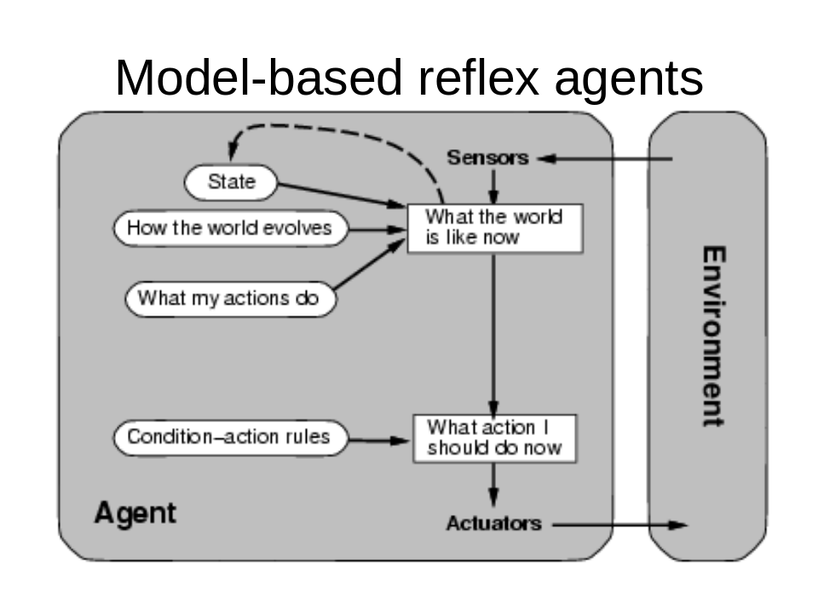
Model based reflex agent (often used in partly observable environments)
Knows something about the environment, independently
agent’s own experience
Knows how the action influences this knowledges
Knows something about the currently unobservable parts
of environment
Has a model of the world in which the task is solved.
No longer term planning.

Slide 41
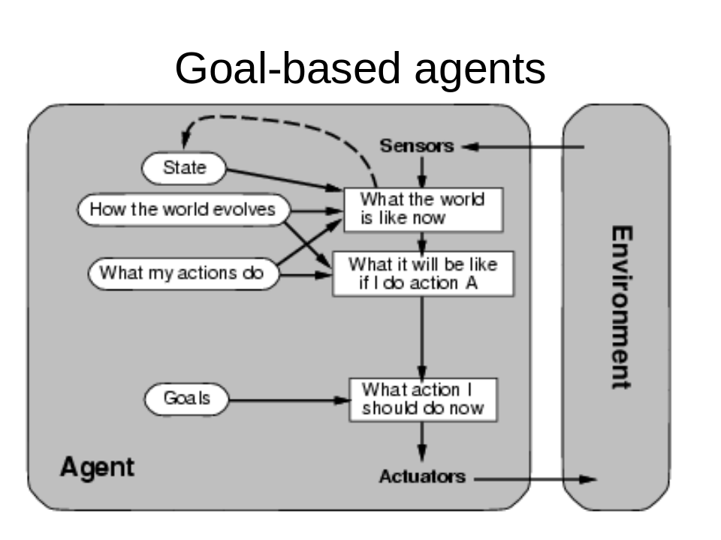
Goal – based – agent
Has an information about the desirable goal states
often uses searching and simple planning to reach the goal
Planning.

Slide 42
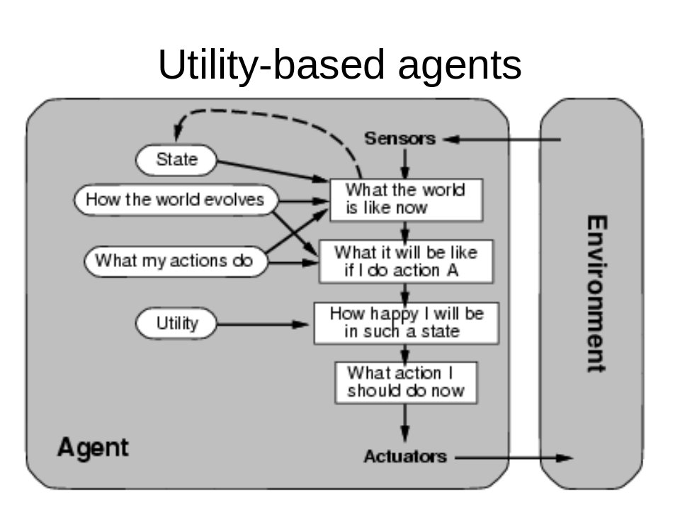
Utility – based agent
-For this agent not only goal is important. The cost of the way to the goal is also important.
- Utility function maps the state, or state sequence to a real number, which measures the cost.
- Utility function helps to choose between more possible ways to the desired goal.

Slide 43
Utility versus performance measure – the difference
Performance measure: Measures the state of the environment, and
how well the agent fulfills the task.
Utility function: Measures the state of the agent, the cost of the
task fulfillment

Slide 44
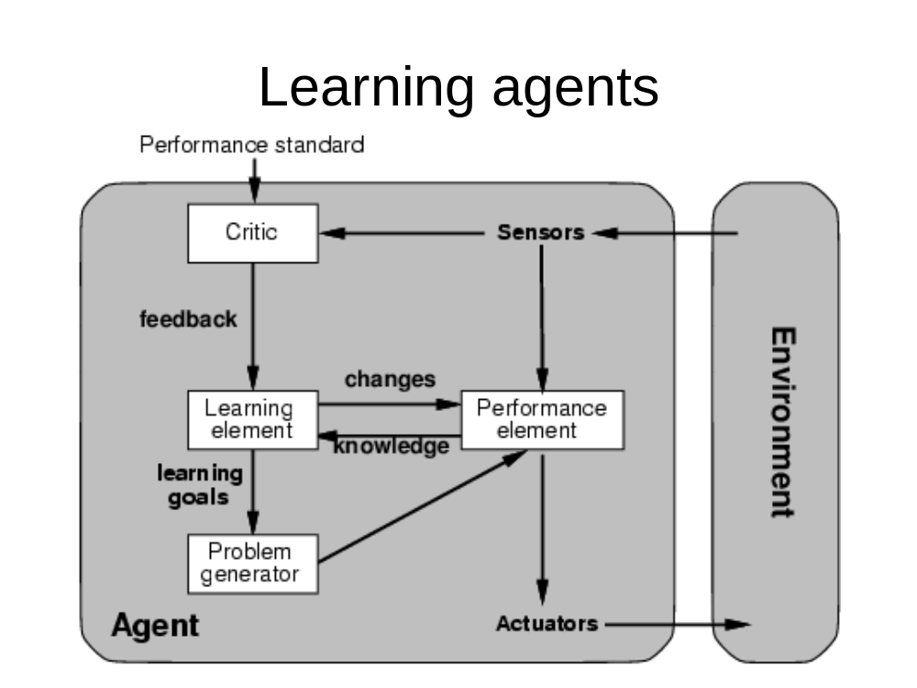
More complex agents with the ability to learn
Simple agent
Learning elements cooperates with performance element
Percept and action selection

Slide 45
Example: automatic taxi driver
Reflex agent: 1. Percepts a car in front of him and slows
down when this car slows .
Model based agent (agent with states):
1. Percepts a car in front of him and slows
down when this car slows .
2. Has a model of the environment, for
example knows what is the average
possible velocity on the highway, second
rate road, field path etc…and slows down
also when the road quality changes.

Slide 46
Goal based agent:
1. Percepts a car in front of him and slows
down when this car slows .
2. Has a model of the environment, for
example knows what is the average
possible velocity on the highway, second
rate road, field path etc…and slows down
also when the road quality changes.
3. Detects the goal state and stops when in this
state.

Slide 47
Uutility based agent:
1. Percepts a car in front of him and slows
down when this car slows .
2. Has a model of the environment, for
example knows what is the average
possible velocity on the highway, second
rate road, field path etc…and slows down
also when the road quality changes.
3. Detects the goal state and stops when in this
state.
4. From various possibilities how to get to the goal chooses
the cheapest one.

Slide 48
Problem solving agent
-it is a goal based agent with some model of the
environment
-able to create a simple plan
-actions are first planned and simulated, then realized
Example: Agent searching for a way on a map.

Slide 49
What one needs to solve a problem? :
- exact formulation of the problem
formultion of goal states – define a set of
desirable states
formultion of the problem (description of
possible actions and states leading to the goal)
- looking for an appropriate searching strategy
- making a plan of actions

Slide 50
Tasks and questions
Suggest an appropriate „performance measure“ for an agent walking around a boundary.
What would be a rational behavior of the agent vacuum cleaner if he gets one good point for cleaning a room. He still have to fulfill the task and clean the rooms.
What would be a rational behavior if he gets one good point for each step. He still have to fulfill the task and clean the rooms.
What would be a rational behavior of the agent vacuum cleaner if he is penalized for each step?
Design an agent vacuum cleaner providing we do not know the geography of the environment. We only know that it consists of small squares becoming dirty in certain predefined time periods. Is it possible to solve the task using only one of the simple agents?

